Slide 1

DiaTwin
Simplifying Life with Type 1 Diabetes
Personalized insulin dosing support for the digital age

Slide 2

The Daily Struggle of Type 1 Diabetes
Managing Type 1 Diabetes is an exhausting, 24/7 responsibility that offers no breaks for the patient. Every meal and activity requires a complex mental calculation to determine the exact amount of insulin needed, a process that is both stressful and prone to error.
24/7
MANAGEMENT RESPONSIBILITY
A single miscalculation can lead to dangerously low blood sugar levels in the short term or devastating long-term organ damage. DiaTwin's mission is to replace this constant anxiety with clinical confidence.
365
DAYS PER YEAR

Slide 3

Your Digital Health Companion
DiaTwin serves as a seamless bridge between raw medical data and the realities of daily life. By connecting directly to the FreeStyle Libre CGM sensor, the app automatically synchronizes glucose readings in the background without requiring any manual entry from the user.
LIBRE CGM
Synced 7 min ago
Real-time Integration
184
Continuous data flow ensures therapy decisions are always based on the most current physiological state.
mg/dL
Automated Insights
Raw sensor data is transformed into actionable guidance, reducing the cognitive load on the patient.

Slide 4
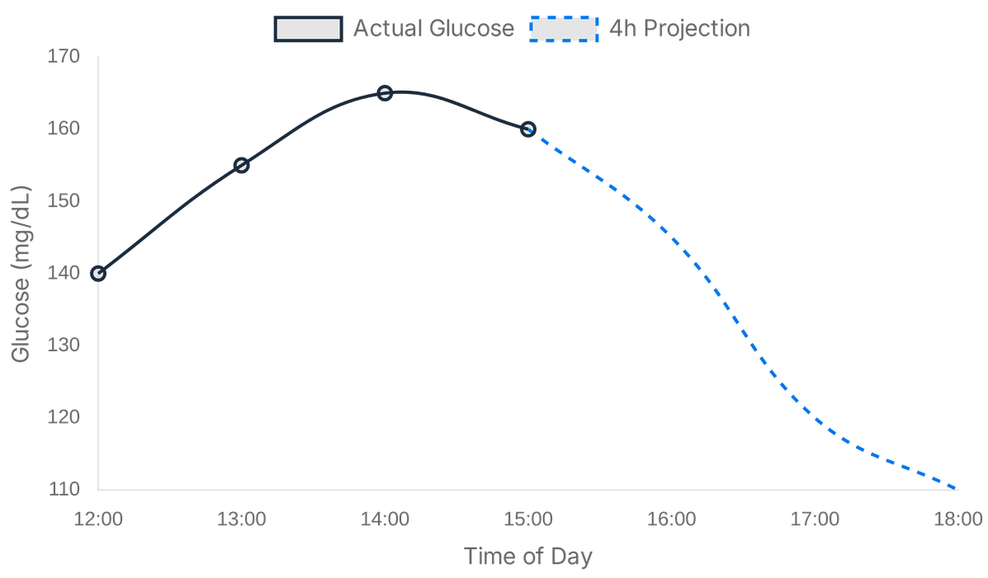
Seeing the Future of Your Glucose
While most conventional diabetes applications only report current glucose levels, DiaTwin empowers users by showing them where their blood sugar is heading.
4-Hour Projection
Our advanced "Digital Twin" technology provides a precise forecast of glucose trends, allowing for proactive planning.
Physiological Baseline
The app learns your unique metabolic rhythm to anticipate changes before they occur.
Source: DiaTwin Pharmacodynamic Engine Simulation

Slide 5

Smart Safety through Predictive Analysis
Safety is at the core of the DiaTwin experience, powered by a sophisticated engine that detects potential health risks before they manifest. The app continuously analyzes the balance between insulin activity and meal absorption.
⚠️
FALLING RISK DETECTED
Proactive Alerts
Insulin is outpacing meal absorption. Consider taking fast-acting carbohydrates.
DiaTwin provides real-time notifications if it detects a "Falling Risk"—a situation where insulin is outpacing the body's intake of carbohydrates.
GLUCOSE PROJECTION
Genuine Safety Net
This predictive capability moves beyond simple data tracking, helping patients prevent emergencies before they even start.

Slide 6

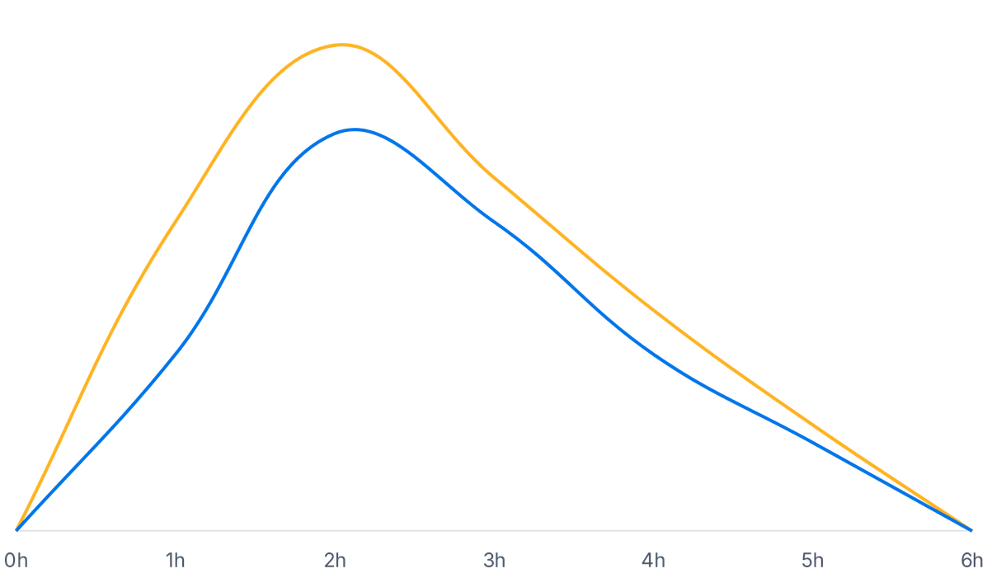
Visualizing Your Body’s Metabolic Balance
DiaTwin offers total transparency into the complex interactions between nutrition and medication through its intuitive effects visualization.
By representing "Insulin on Board" and "Carbohydrates on Board" as overlapping curves, the app allows both patients and clinicians to see the net effect of every action in real-time.
Insulin Effect (IOB)
Carbohydrate Absorption (MOB)

Slide 7
Effortless and Accurate Meal Logging
We believe that logging nutrition should be as simple and intuitive as the act of eating itself. DiaTwin allows users to record their meals in seconds using a verified food database and flexible portion options.
MEAL LOGGING
AI RECOGNITION
Search: "Spaghetti"
Portion: "Full Plate"
65g Carbs
Intuitive Portions
Calculated Instantly
[ Camera View ]
Use real-world measurements like "palm-sized" or "full plate" to estimate intake without a scale.
Detected: Apple
Instant Macro Calculation
Confidence: 98%
The application automatically calculates carbohydrates, proteins, and fats, ensuring dosing is based on accurate data.

Slide 8

Personalized Dosing Made Simple
Taking the guesswork out of insulin dosing is fundamental to improving the quality of life for Type 1 Diabetes patients. DiaTwin calculates a precise, personalized insulin dose by accounting for the user's real-time physiological state and specific physician-set parameters.
Carbohydrates
+ 4.2 Units
Blood Sugar Correction
+ 1.8 Units
Active Insulin (IOB)
- 0.5 Units
Active Carbs (MOB)
+ 1.3 Units
Transparent Logic
6.8 Units
Recommended Dose
Every calculation is presented with complete transparency, showing exactly how the recommendation was reached based on correction needs, active insulin, and meal macros.

Slide 9




Clinical Oversight and Regulatory Excellence
Physician-Led Care
Data Sovereignty
German Standards
Doctors maintain a clear, remote view of patient data and trends. Critical medical settings and safety limits remain locked to ensure clinical safety.
Fully compliant with GDPR and German health data regulations. We ensure the highest standards of privacy and security for sensitive patient information.
Built according to S3 Clinical Guidelines. Strategically positioned for seamless integration into the German DiGA reimbursement framework.
CE CLASS IIA
DIGA READY
GDPR COMPLIANT
S3 GUIDELINES

Slide 10
A Scalable Solution for the Mass Market
VALIDATION
REACH
GROWTH
TRL 6-7
Millions
DiGA
Clinically Proven
Mass Market Focus
Reimbursement Path
DiaTwin has demonstrated its utility through patient trials, achieving "Excellent" reviews for safety and user satisfaction in real-world validation.
We bring precision care to the millions using simple insulin pens, addressing a massive gap left by expensive and complex pump systems.
With a clear path to insurance reimbursement via the German DiGA fast-track, DiaTwin is uniquely positioned for rapid, sustainable scaling.

Slide 11

Ready to Transform Diabetes Care Together
Our team combines deep clinical expertise with cutting-edge digital technology to bridge the gap between complex data and daily well-being. Join us in making life with Type 1 Diabetes safer, simpler, and more predictable.
Lead:
Ali Attia
Email:
ali.attia@gmx.de
Web:
dia-twin.vercel.app

